Slide 1
Advance Slicing
By Friend

Slide 2
Pre-workshop
Download and install Meshmixer
I’m using Meshmixer 3.5 for the slides, but any version should be fine
Download the model of the rabbit with hole from Github

Slide 3
If there’s a word you don’t understand in the slide, let me know and I’ll add it here
Topology: organization of vertices in a mesh
Vertex: a point in a mesh model; a model is made up of many vertices

Slide 4
Note
I’ll use “” for button clicks

Slide 5
Agenda
Import and export files, navigating
Repairing holes in models
Smoothing
Basic Retopologizing
Cutting models
Tree support

Slide 6
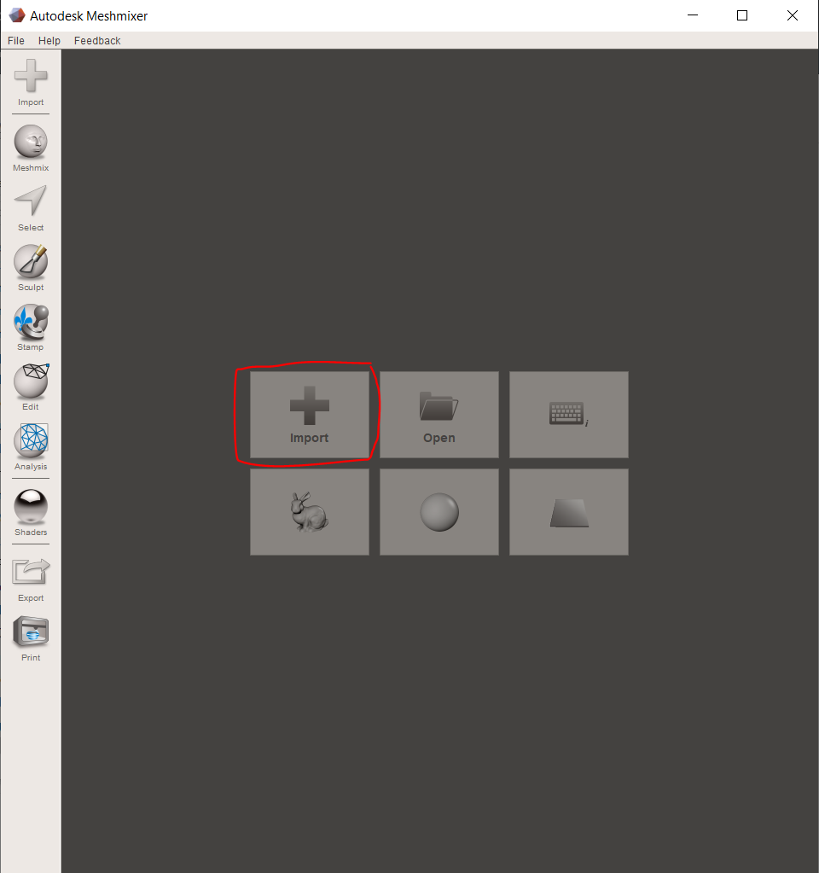
Import
You should see this screen when you first open
Import the rabbit

Slide 7
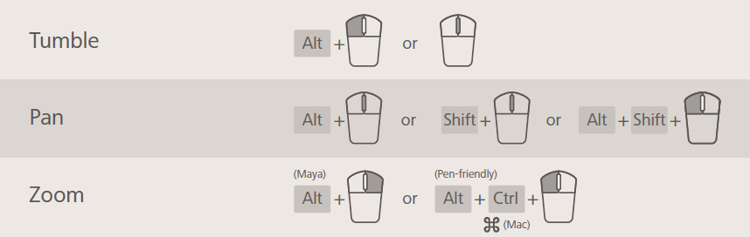
Navigating

Slide 8
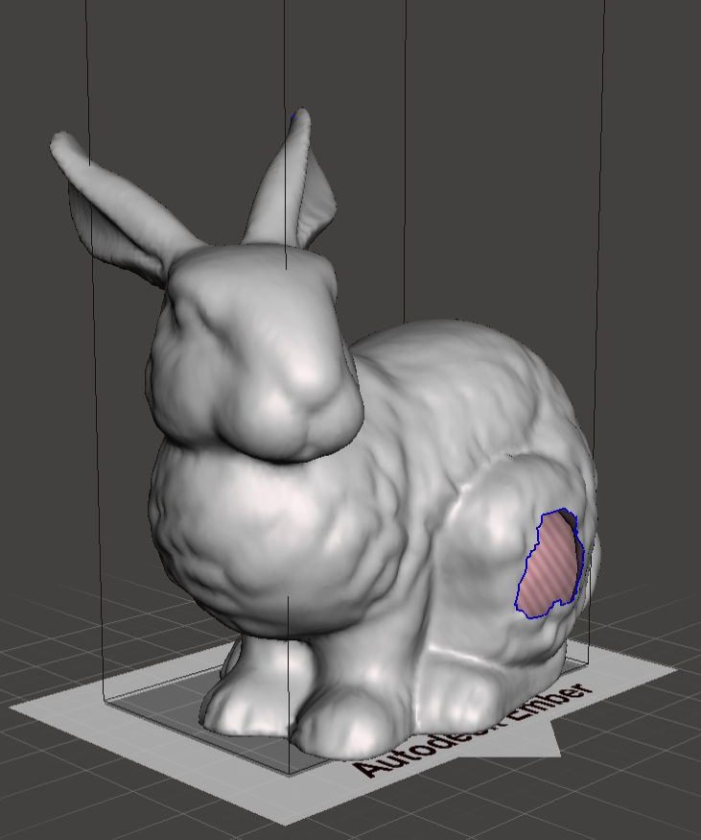
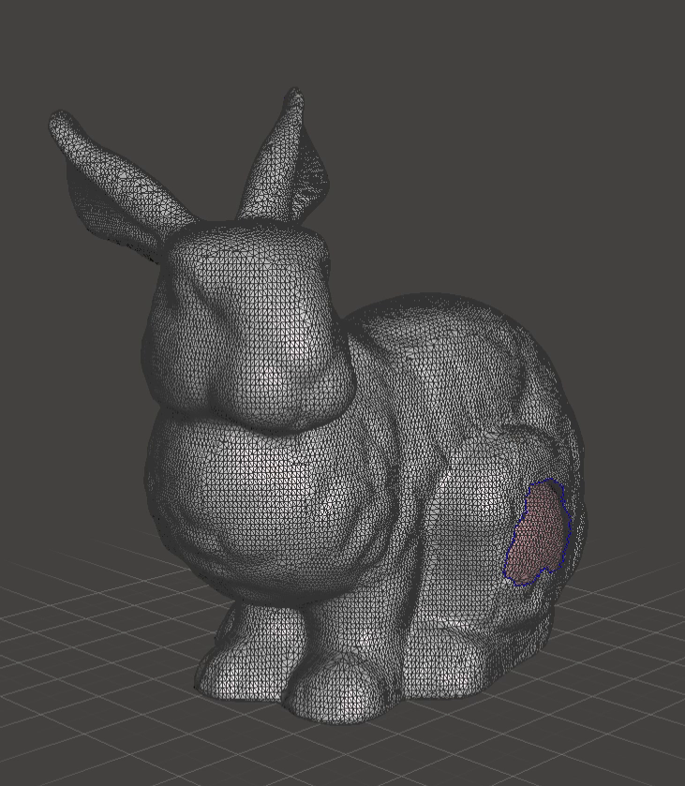
View
On the toolbar on the top, there’s “View” option
For this WS, I recommend turning on wireframe, and turning off bed

Slide 9
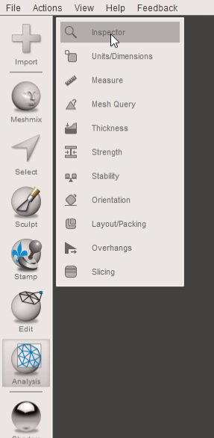
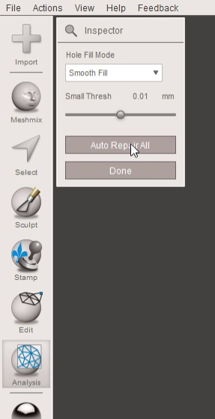
Hole repair
On the left toolbar, “Analysis”->”Smooth Fill”->”Auto Repair All”
Process is fairly automated in Meshmixer
Different fill for different mesh
I used Smooth Fill since the rabbit is an organic model

Slide 10
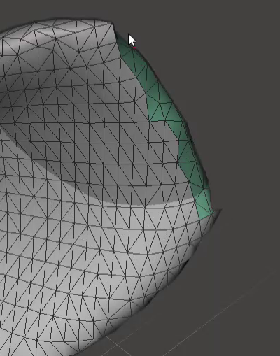
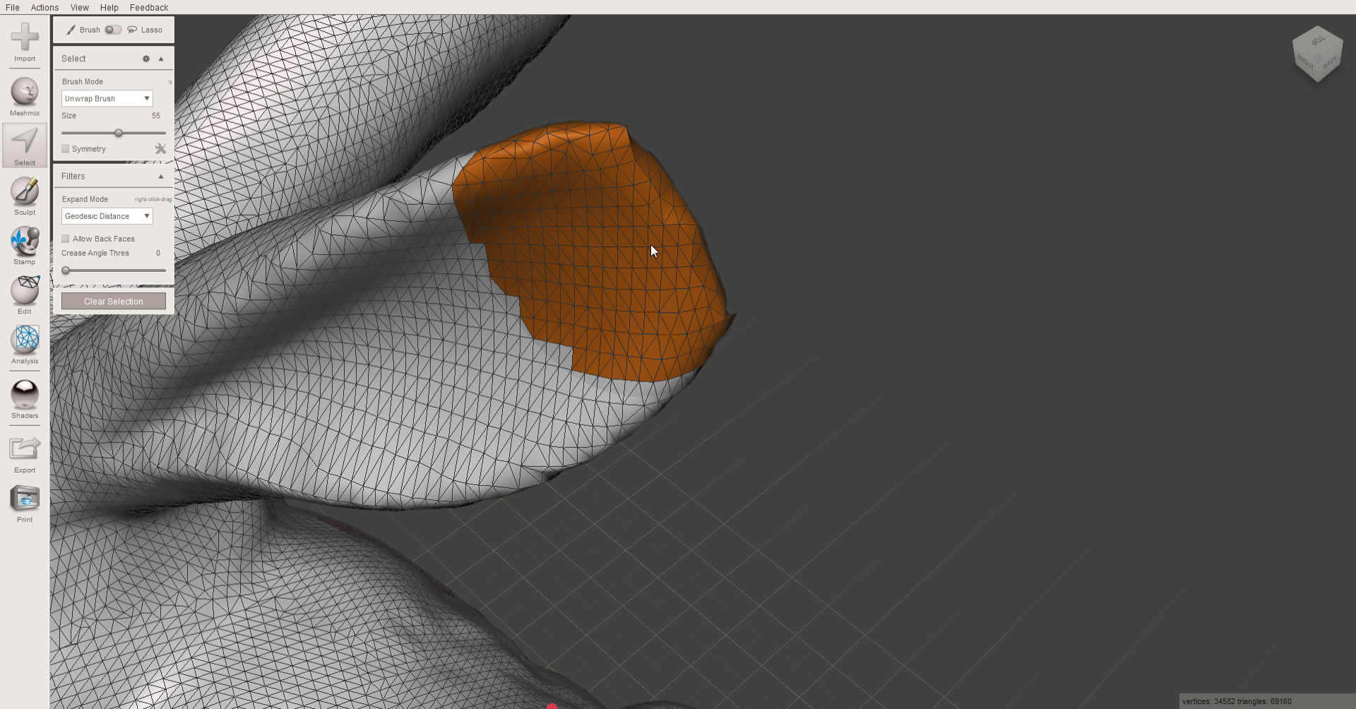
Smoothing
Notice that the ear that was filled looks truncated
We can smooth it out
On the left toolbar, click “Select” and use the round brush to select the tip of the ear

Slide 11
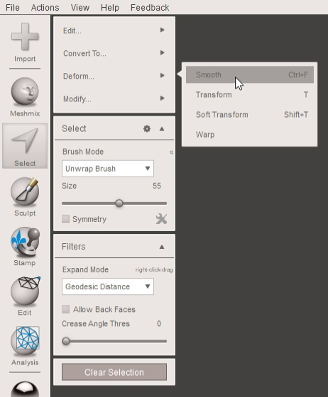
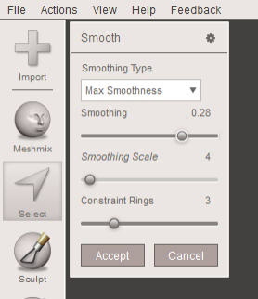
Smoothing
Once you’re done selecting, another set of buttons should pop up
Go to “Deform…”->”Smooth”
Play around with the settings so the ear looks nice

Slide 12
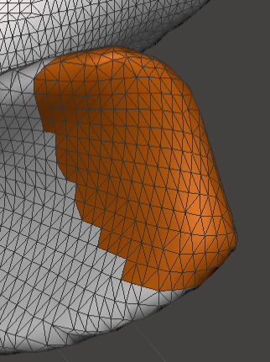
Smoothing
Before and after

Slide 13
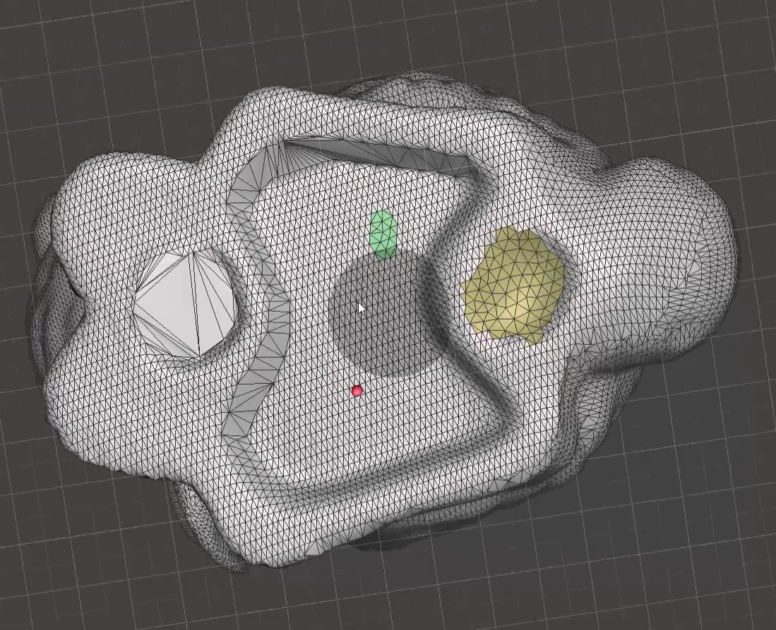
Remesh
Rotate camera so you see the bottom
You can see that there’s a lot of vertices for just a simple flat surface
This makes the model larger and more complicated than it should be
We can retopologize it (Meshmixer calls it “remesh”)

Slide 14
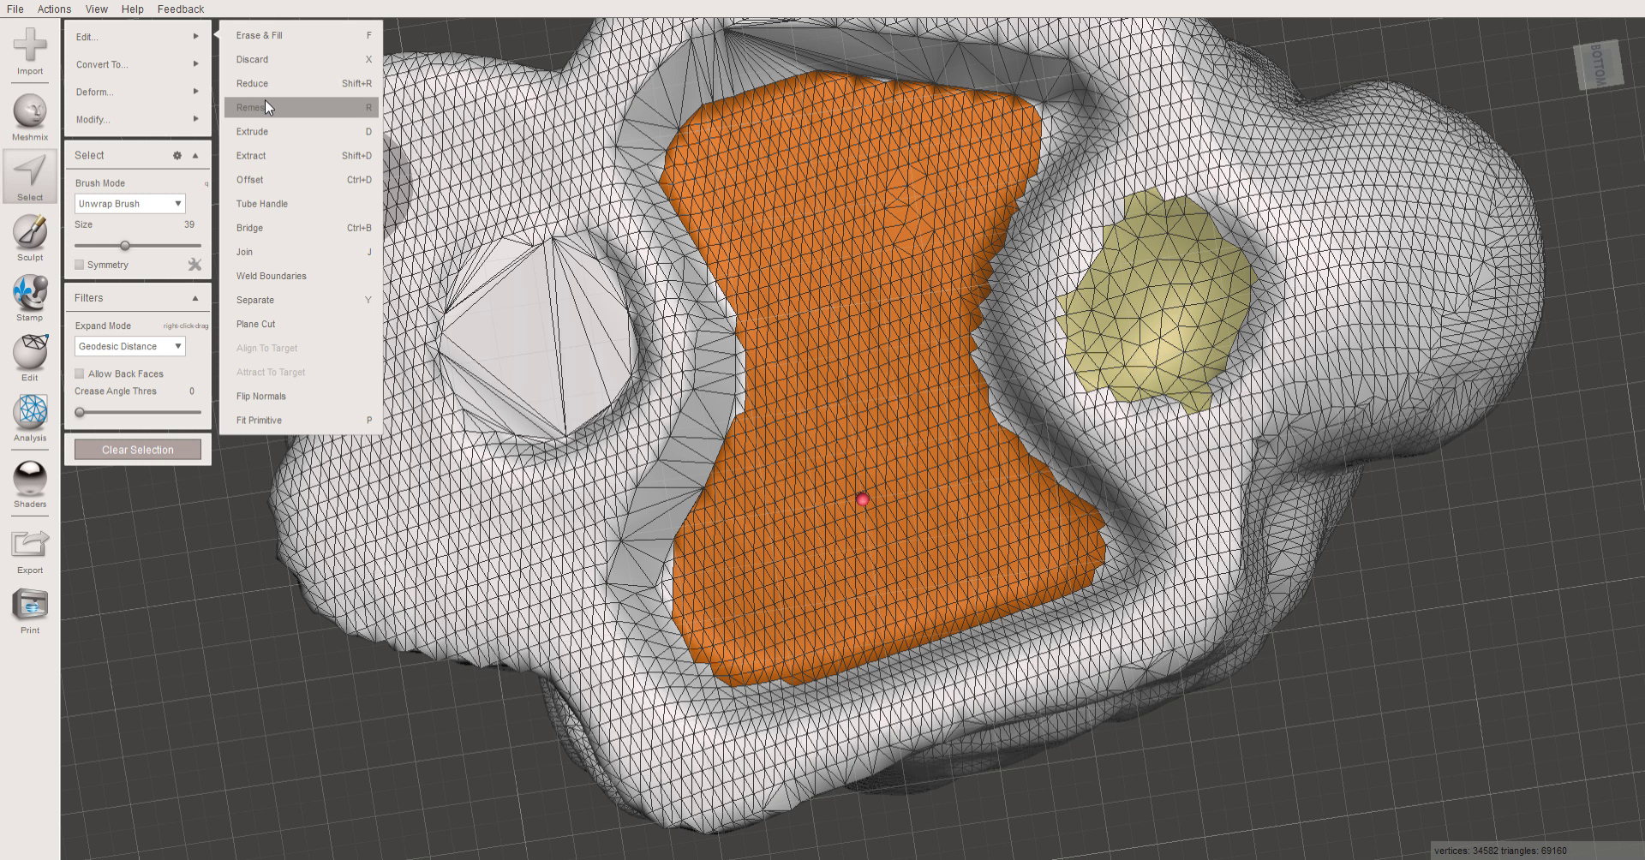
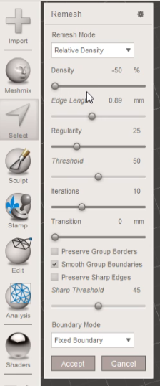
Remesh
Click “Select” and highlight all the vertices on the flat part
Go to “Edit”->”Remesh”
Play with the settings to reduce the amount of vertices to the least you can

Slide 15
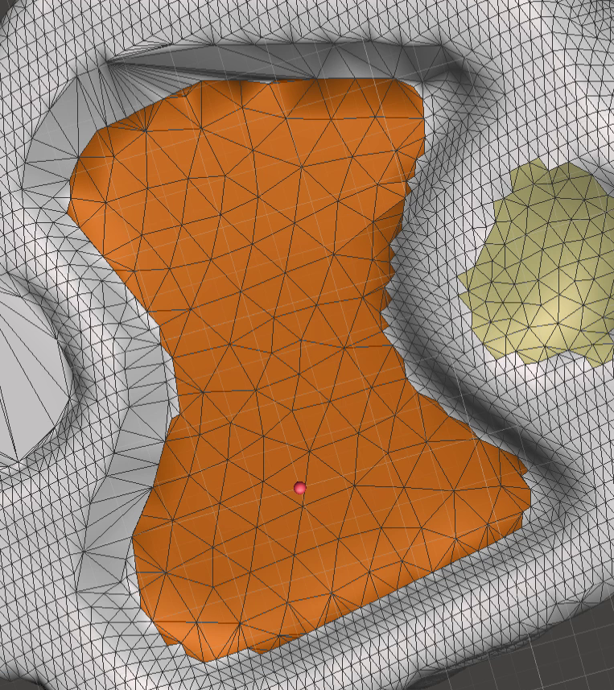
Remesh
Before and after

Slide 16
Remesh
Before and after

Slide 17
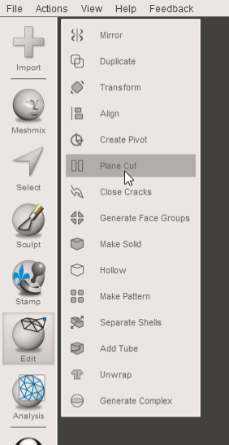
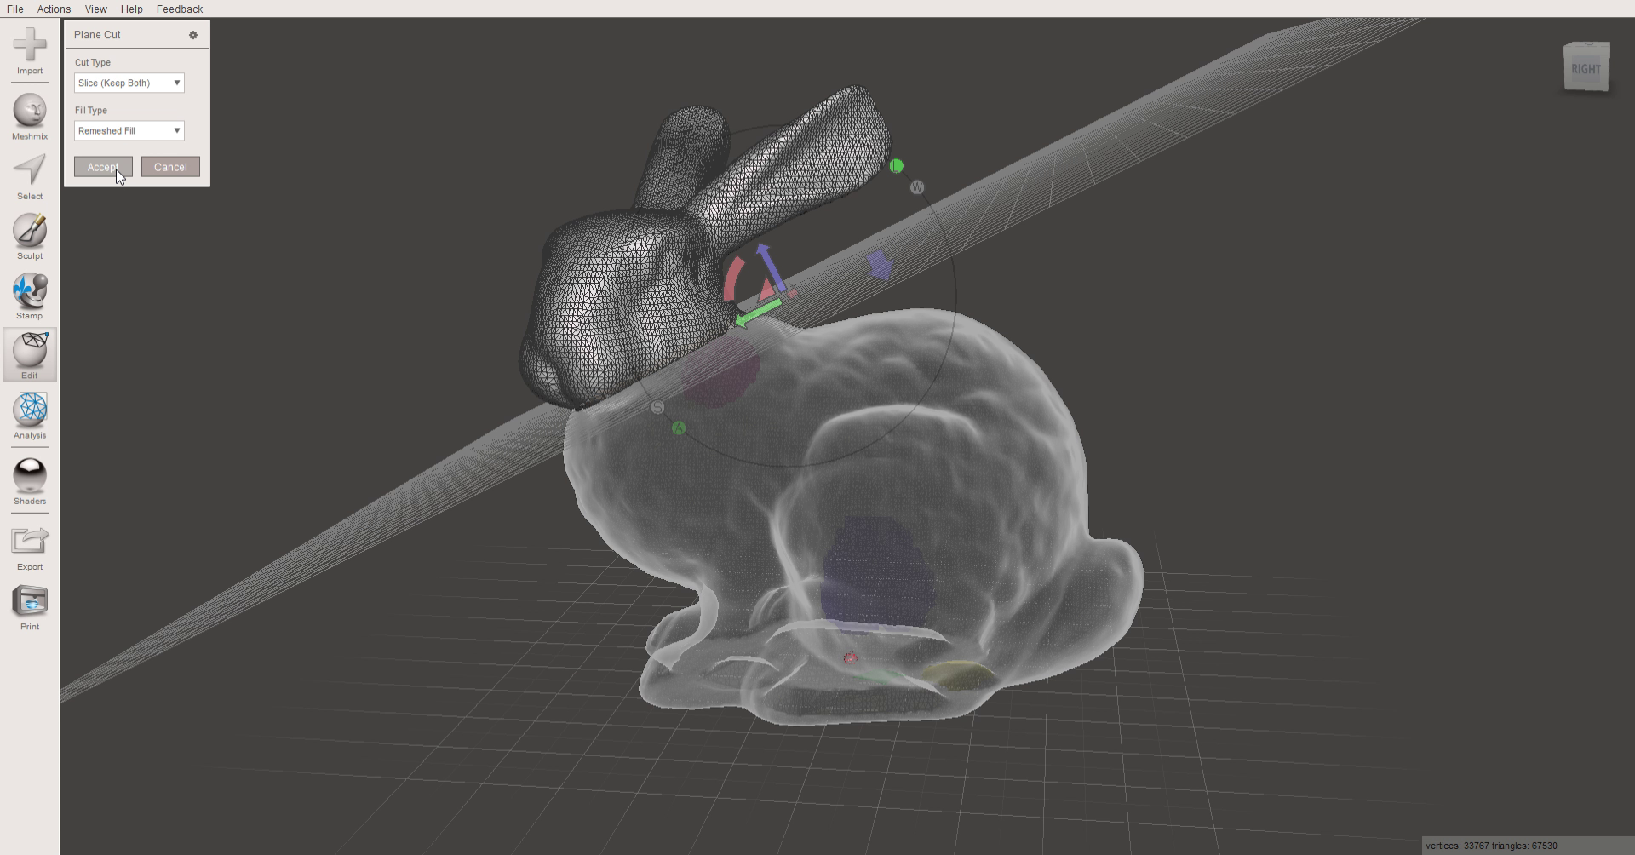
Plane cut
Sometimes you want to cut a model into more printable chucks
Too big for printer, overhang wasting supports, get rid of overhang altogether, etc.
Use plane cut by going to “Edit”->”Plane Cut”
Use arrows to translate the plane, and the quarter-circles to rotate the plane

Slide 18

Plane cut
Once you’re happy with plane location, change Cut Type to “Slice (Keep Both)”
Click “Accept” to make the cut
Go to “Edit”->”Separate Shells” to make them separate models

Slide 19
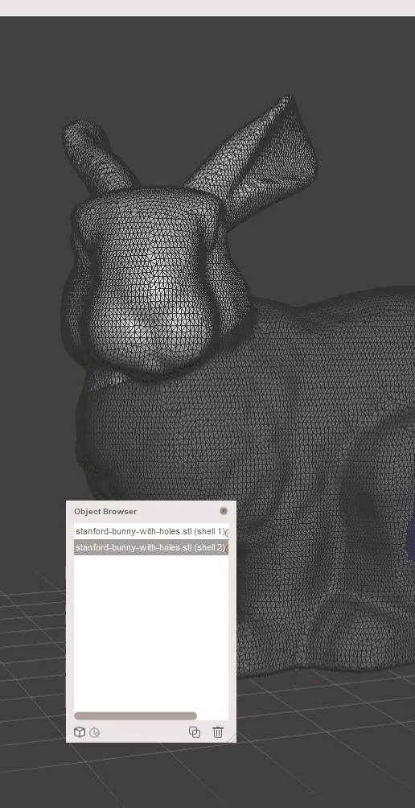
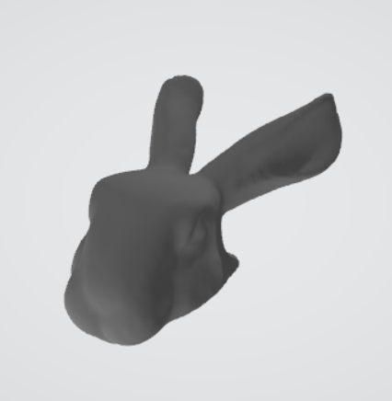
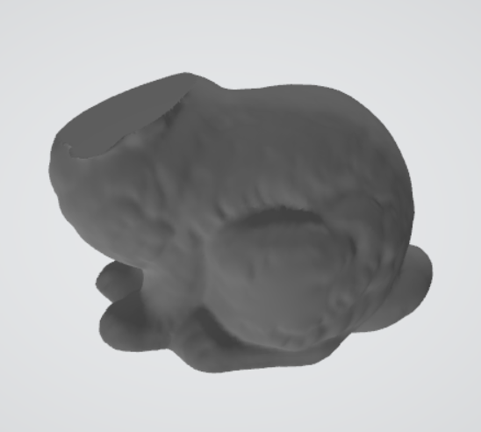
Plane cut
You can select the model you want and export the models individually
Go to the top toolbar, “File”->”Export” to export the selected model

Slide 20
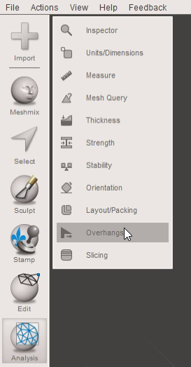
Tree Support
You’ve seen grid support in previous WS
They take up quite a bit of plastic, and are difficult to remove, aren’t they
Tree support is generally less wasteful and easier to remove
On the left toolbar, “Analysis”->”Overhangs”

Slide 21
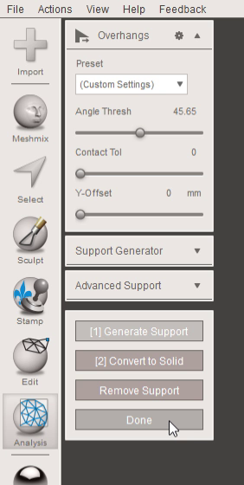
Tree Support
You can change Angle Thresh to 45deg
I’ll leave other settings for you to explore
Click “Done” to generate tree support
Try generating and ctrl-z-ing a few times to get an idea of what each setting does to the support

Slide 22
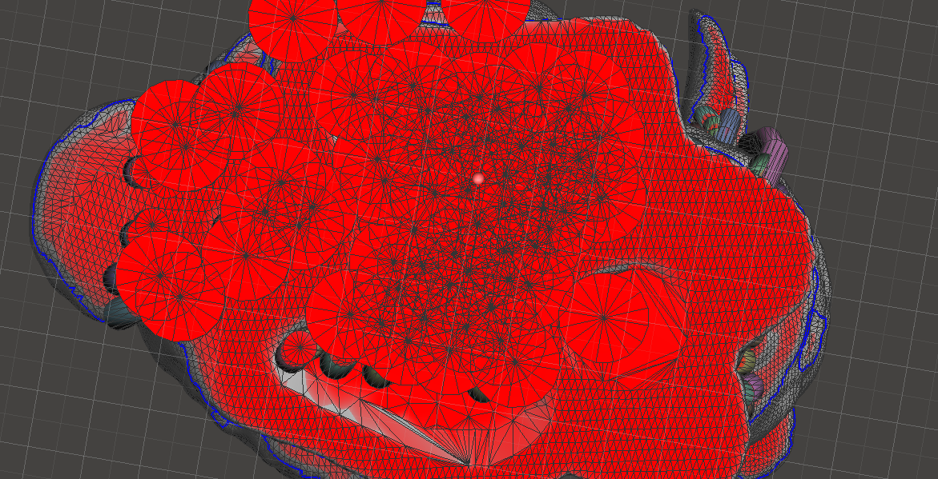
Oh No
Rotate to the bottom
You’ll see that there’s a bunch of support generated for the groove on the bottom (the bump that we retopologized)
Do we really need that groove? Can you get rid of it altogether?

Slide 23
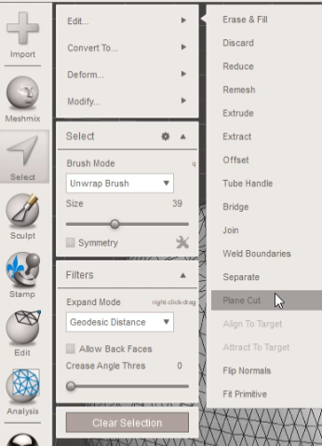
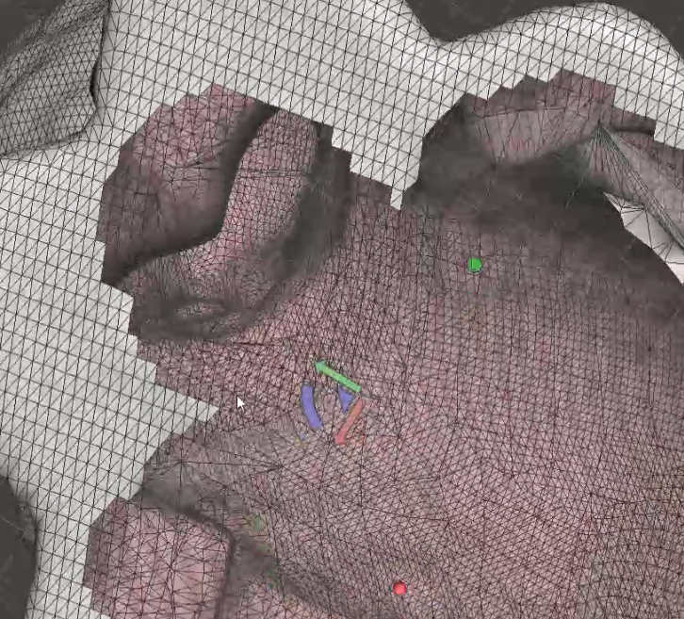
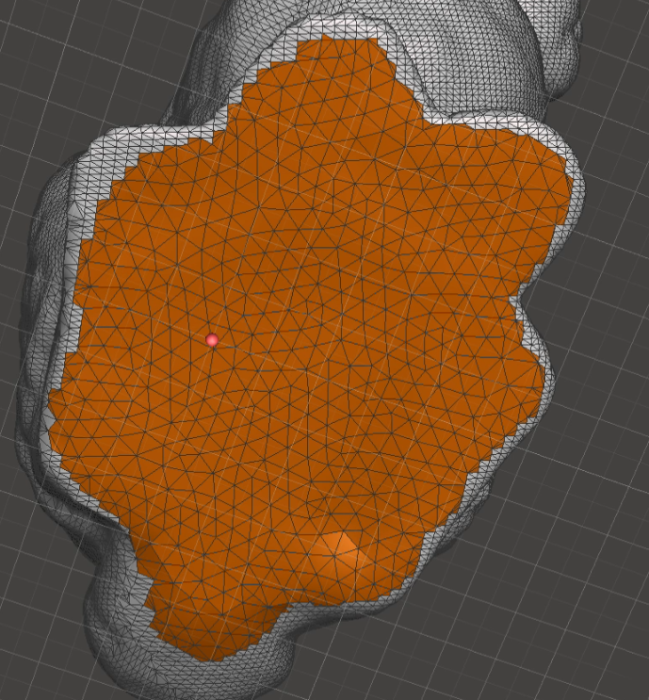
Exercise
As an exercise, I’ll let you figure out a way using the skills we learned previously in this WS
I did it by exploring the software a bit and breaking the problem down into steps:
Select the problematic grooves
Do a plane cut on them
Fill the giant hole created
Remesh it to make it efficient
You don’t have to do it this way

Slide 24
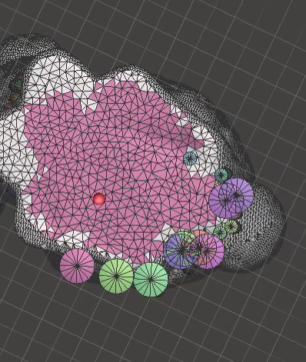
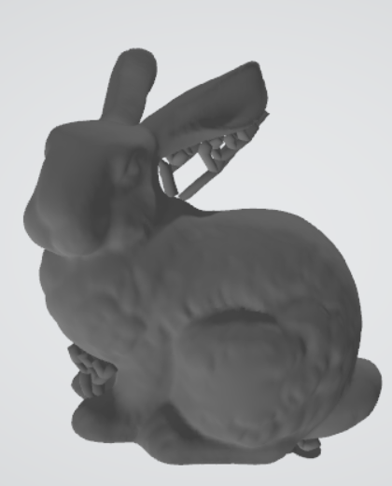
Exercise
Generate tree support again and rotate to bottom
You should see that there’s no wasteful supports generated now
Export it

Slide 25
Homework
Distributed in WS

Slide 26
Some further readings
These are where I got WS material from, and there’s a lot more content I didn’t cover in them:
http://www.diva-portal.org/smash/get/diva2:1222615/FULLTEXT02.pdf
https://blog.prusaprinters.org/cut-stl-models-3d-printing-meshmixer/
If you want to get ahead, Basic Mesh Modeling WS uses Blender which does everything that Meshmixer does, but much more
Cura also does tree support, although it is less customizable; I highly recommend you look at it

